Slide 1
Climate Change Model
Cliff Gold

Slide 2
Agenda
Introduction
Example Run
Inspiration
Model
Try It Out

Slide 3

Introduction
As we struggle against Climate Change, it has become obvious that the interactions are very complex.
Decision making is very difficult, balancing all these factors.
This model uses a computer simulation to see the effects of various policies.

Slide 4
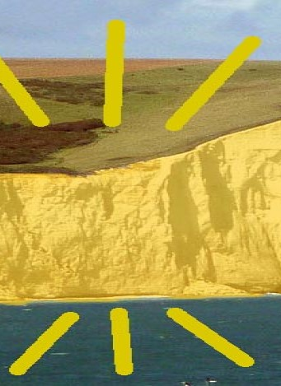
Introduction
I’m Cliff Gold, a retired chip designer.
In chip design, a single mistake – a single gate in a design with billions of gates – can cost millions of dollars and months of delay.
At a gigahertz, a mistake with a one in a billion chance happens once a second.
I’ve learned to become appreciative of those finding bugs in my design.
I’m also ridiculously picky.

Slide 5
Inspiration
Observations
PUC meeting on why they didn’t shut down Diablo Canyon
Enroads conclusions on Nuclear, and how their model worked?
Goals
Develop a model that is demand-based, and without outages.
Be able to easily explore different scenarios.
Show exactly where the numbers come from.
Be able to explain how the overall model works.

Slide 6
Sample Run

Slide 7
Building the model: Input
The EIA (Energy Information Administration) has hourly energy data which gets updated every day.
Used the 4 years from 2020 – 2023 inclusive. That’s 35,064 points, for each Solar, Wind, Nuclear, Gas, Other. For each of 13 regions. 2,279,160 Data Points
Other information like cost, lifetime, etc. also from EIA where possible
Links to the source data are provided in the spreadsheets.

Slide 8
Building the model: Calculation
Do Next Year
Last Year’s Hourly Usage
End Of Life
Base Hourly
Usage
Build Capacity/
Use Capacity
No
No
Best?
Yes
27 Years?
Total Hourly Usage
Demand increase
Calculate Cost
Yes
NRG/ CO2 Prices, Etc
Case Mods
Put in Library

Slide 9
Building the Model: Library
Standard format for paths
Price of CO2 – increasing or constant – 5 levels each
Run separately for each of 13 regions
One “Case”, with 10 CO2’s, 13 regions takes about 1 Hr 40 min
It goes through hourly loop about 25 billion times

Slide 10
Try It Out!
Run Excel
The link to instructions for downloading are:
Slack: GenA/team-comms-outreach
Slack: CCLSVE/General
CCL Nuclear: https://community.citizensclimate.org/groups/discuss/2592/2857
Try out a bunch of scenarios.
DM me with questions:
Why is there this funny bump in the data
How about the case where this and that happens
Could you graph this vs. that?
Deep Dive
Everything is in github.com/cliffgold/optimize

Slide 11
Special Thanks To
Aarav Garg for getting it to run on Mac
Joseph Sauer for Excel suggestions
Lucas for working with EIA to get storage numbers right.
Rory Edelson for setting up the EIA download program, my first real Python experience.
The EIA
Eric Meyer for inspiration
All the others who helped with discussion, advice, and vision

Slide 12
Thank You

